Slide 1
Category review: Chips
June 2020
Retail Analytics
Brand note: If client logo is not required, use alternate title page layout right click slide thumbnail > Layout > Title

Slide 2
Notes:
To view Privacy video explaining how important data privacy is to Quantium, please click here: https://www.youtube.com/watch?v=Zq1QDAkoRzU
or here Q:\Company Reference\Brand & Design\Brand videos\Q Privacy.mp4
At Quantium, we believe that data is the behavioural footprint of humanity and that it has to be treated with the utmost care and responsibility.
Histories, attitudes, indeed lives are stored within it in ways that aren’t always apparent – and that’s what makes its potential so powerful.
To work with it responsibly, sensitively, we set ourselves the highest data privacy protection and governance standards.
We have spent 17 years perfecting privacy-by-design and secure-by-design principles. Central to this is not holding any personally identifiable information about people –
we neither receive it, and put the necessary protections in place to be unable to decipher it.
Every aspect of handling data is safeguarded: from its de-identification, to its encryption – data security is paramount and of the highest grade.
We pride ourselves on gaining the trust of iconic organisations around the world through years of securely working with their data,
and in turn the trust that builds with their stakeholders.

Slide 3
Executive summary
01
Task 1
Older Families on a budget are our most valuable customers, and Kettle is the most popular chip brand across every type of customer.
02
Task 2
The trial was successful in Store 77, where sales grew significantly because the store kept more of its existing customers, while a similar untested store lost customers over the same period

Slide 4
01
Category

Slide 5
A small number of customer segments — particularly Older Families and
Young Singles/Couples — account for a disproportionate share of total
chip revenue, making them the highest-priority segments for retention
and growth.

Slide 6
Customer affluence (Budget, Mainstream, or Premium) has surprisingly little
effect on how much a customer spends on chips — average spend per customer
is fairly consistent across all three tiers within each life stage. Revenue
differences between segments are driven more by customer volume and
purchase frequency than by how much premium customers spend per visit.

Slide 7
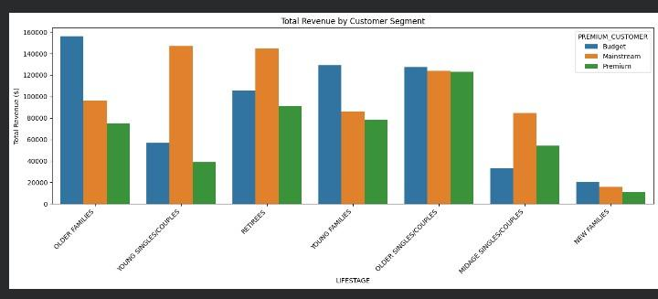

Slide 8
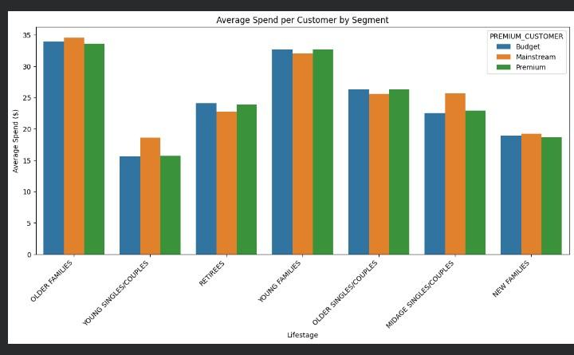

Slide 9
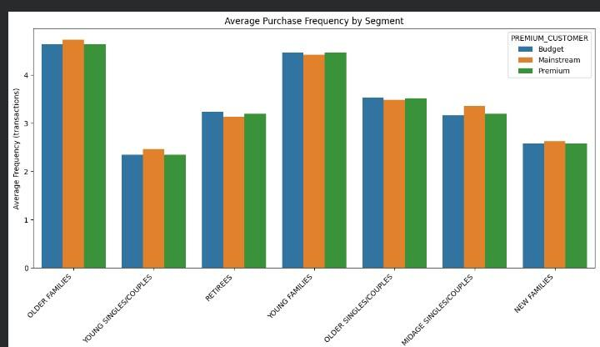

Slide 10
02
Trial store performance

Slide 11
To know if the trial actually worked, we needed a fair comparison. For each
trial store, we found another store with a very similar sales pattern in
the months before the trial started, and used it as a benchmark. This way,
any difference we saw during the trial could be attributed to the trial
itself, not just normal store-to-store differences.

Slide 12
The trial was successful in Store 77, where sales grew up to 66% higher
than its matched benchmark store by the end of the trial. This growth was
driven mainly by the store retaining more of its existing customers,
rather than a big increase in how often each customer bought. Results
were mixed in Stores 86 and 88, suggesting the trial's success may depend
on store-specific factors that need further investigation.

Slide 13
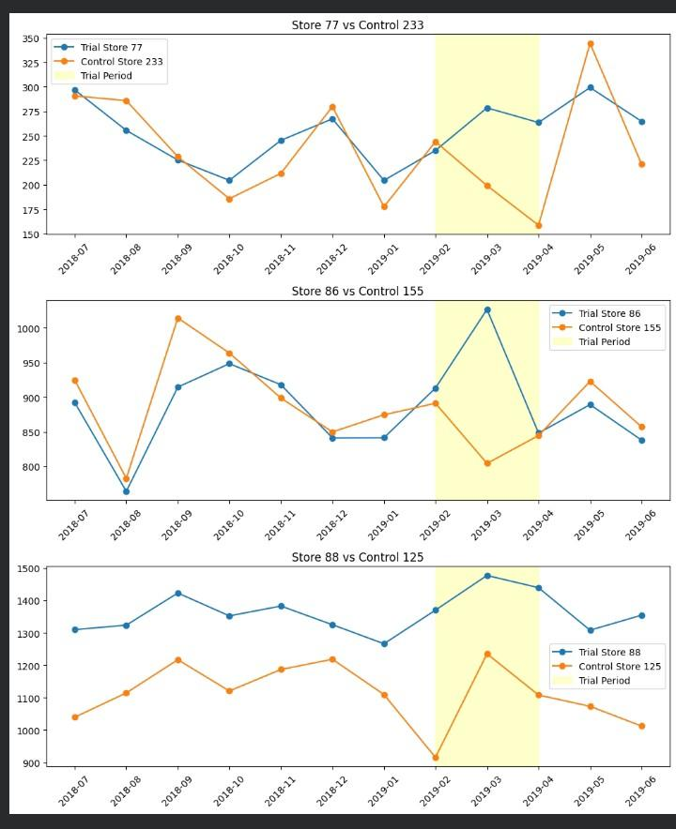

Slide 14
